Slide 1


Mobile application development using Android Studio
S. Durga Praveena
MAD Lab
IDRBT

Slide 2
Overview
Downloading and installation of android studio.
Setting up development environment.
Android HelloWorld App Example
Android Project Folder Structure

Slide 3

Downloading Android Studio
In any web browser navigate to the website.
https://developer.android.com/studio
In that site you will see a download button as shown below.
On clicking this button, browser will open an agreement form. Click on I agree checkbox.

Slide 4
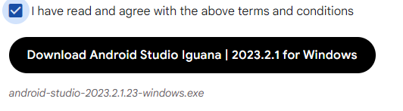
Downloading Android Studio
Once above steps are completed click on the button shown below.
The above step will download a file name called “android-studio-2023.2.1-windows.exe” in the downloads folder of your system.

Slide 5
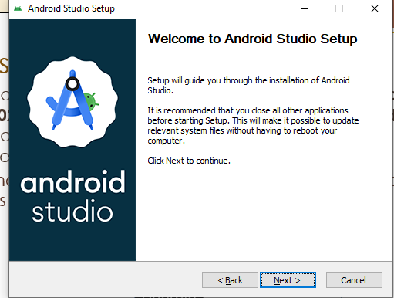
Installing Android Studio
Double click on the executable file “android-studio-2020.3.1.24-windows.exe” available in downloads folder to start the installation process. This will open a new window as below.
The first page will be the Welcome page in the setup guide as shown below.

Slide 6
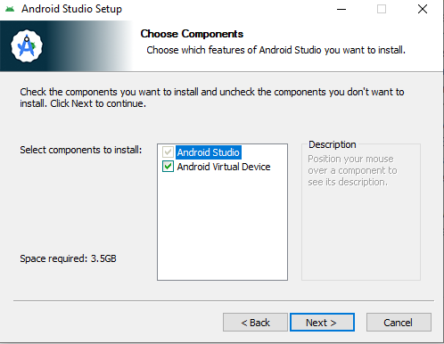
Installing Android Studio
After the above step, setup will go the next page.
After clicking on next, next and install.

Slide 7
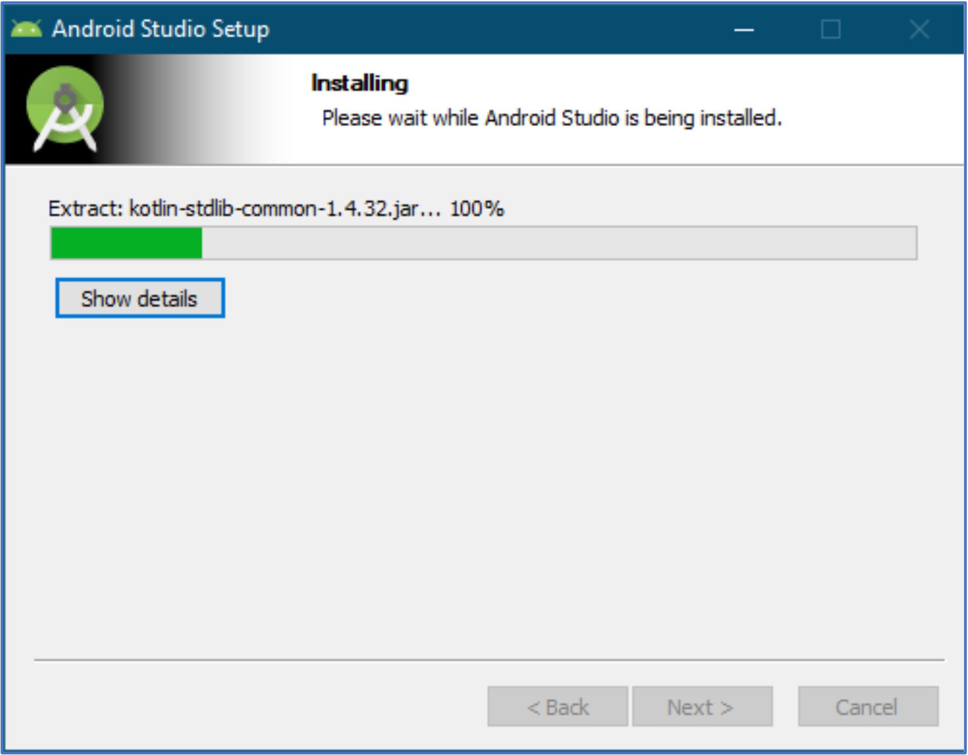
Installing Android Studio
After clicking on install, the installation process will start.
Progress can be seen through the Progress bar as shown below.

Slide 8
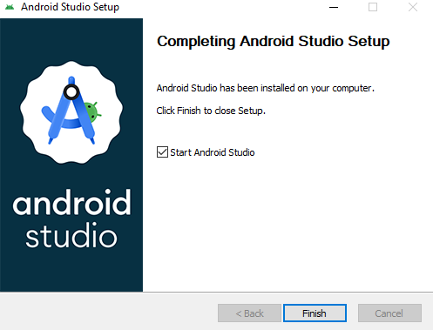
Installing Android Studio
Once the installation is completed, progress bar will be full with a message “Completed” as shown below.

Slide 9
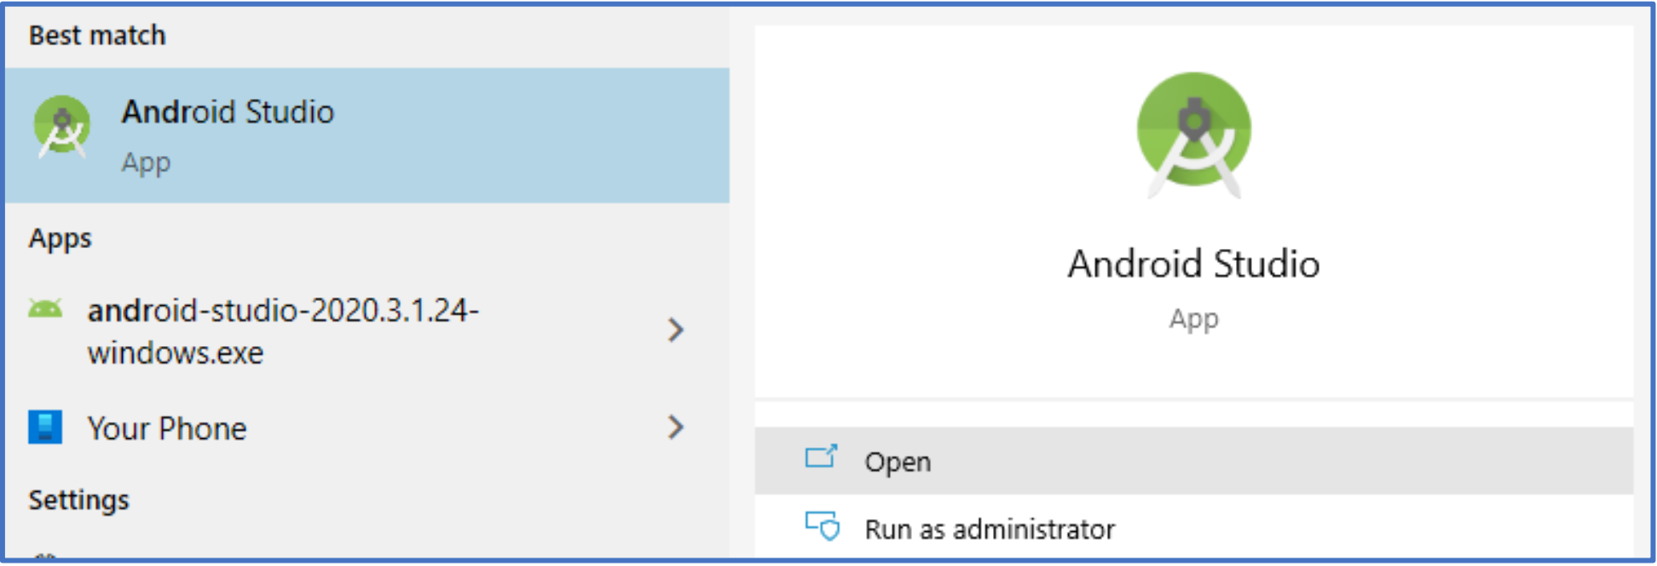
Launching the IDE
In the start menu, search for Android Studio and launch the application.

Slide 10
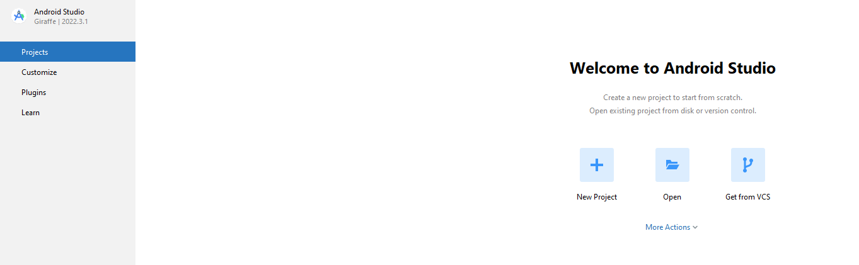
Launching the IDE
This will launch Android Studio, welcome screen shown below.
Click on “New Project”.

Slide 11
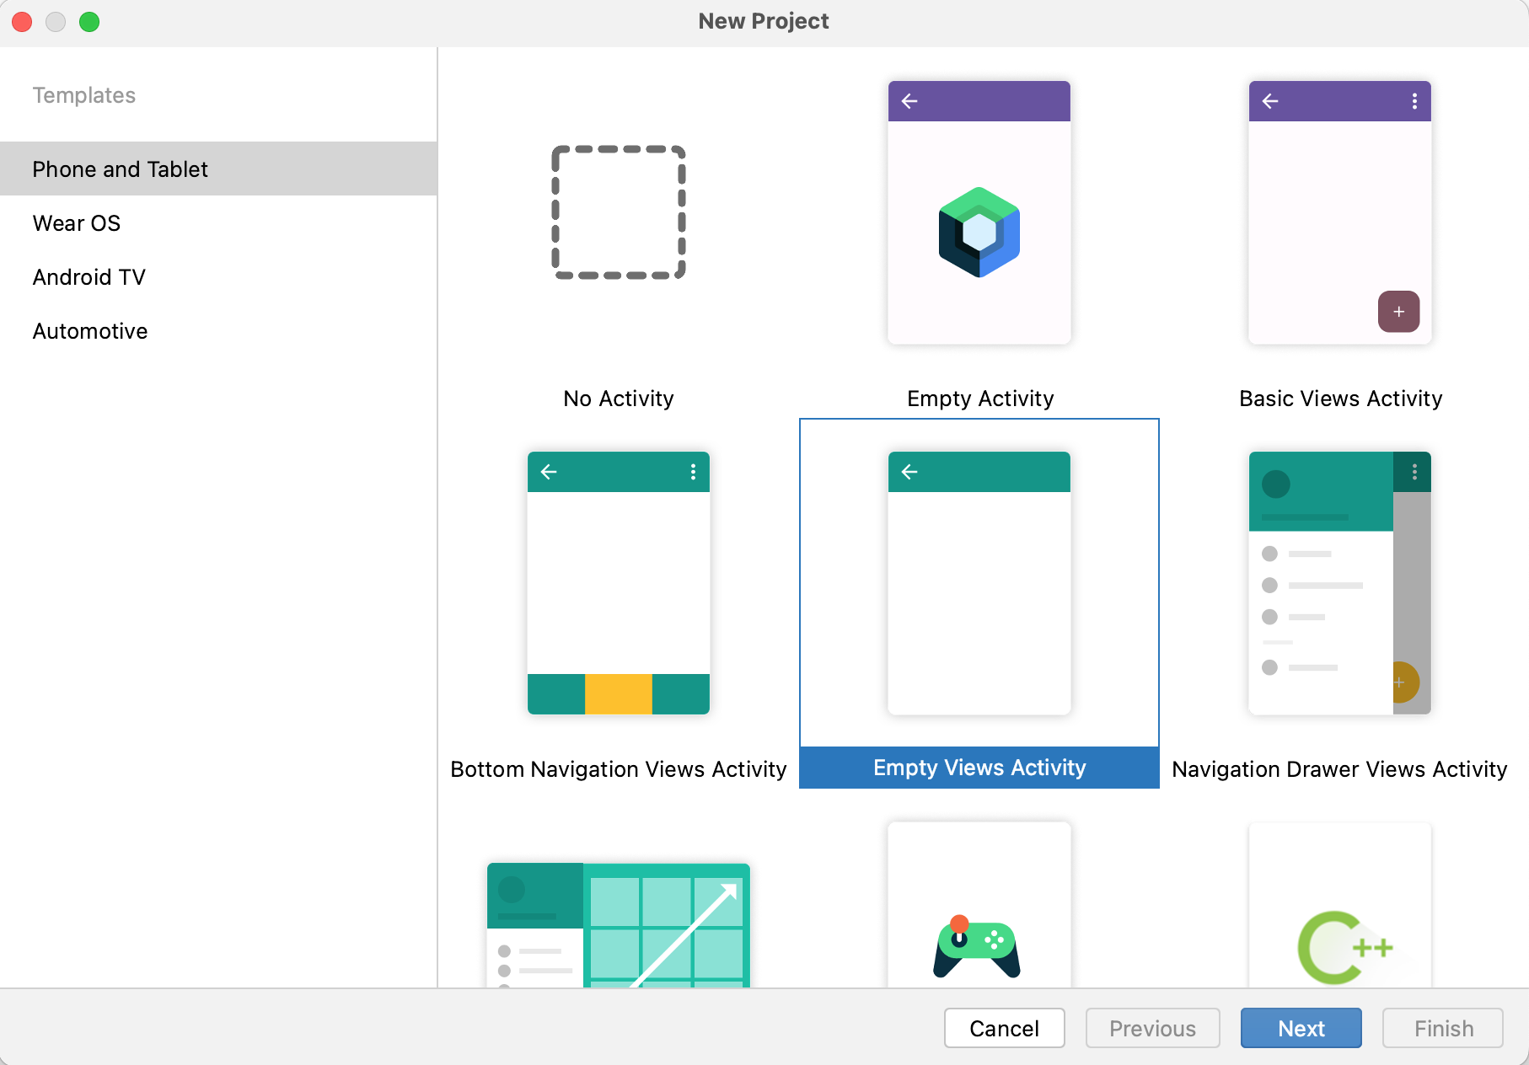
Creating a new project
Under “Phone and Tablet” tab select “Empty Views Activity”.

Slide 12
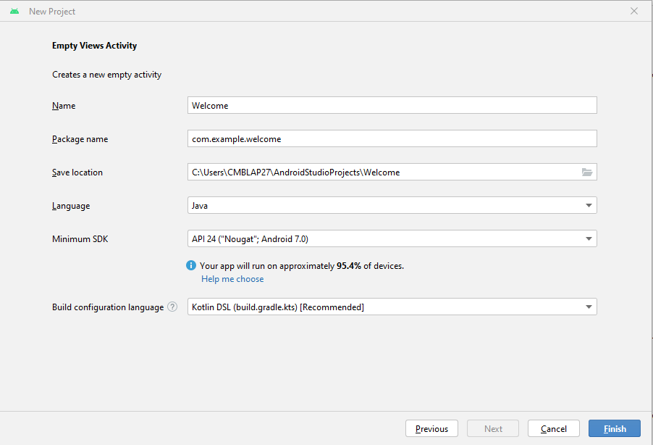
Creating a new project
Change Project name and preferred programming language.

Slide 13
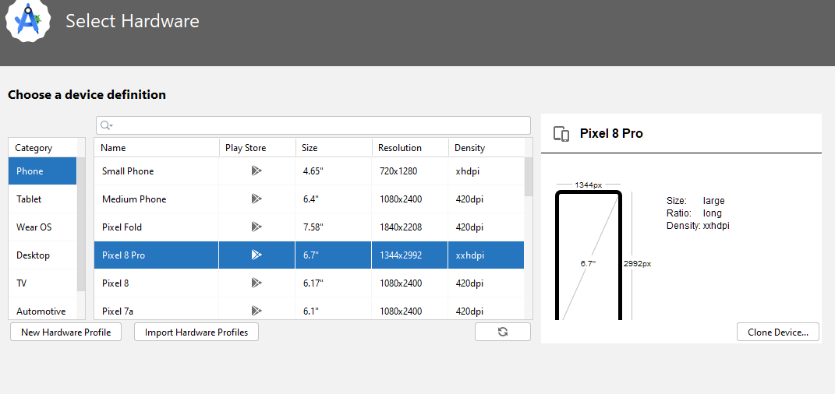
How to download emulator
Select hardware (Android Device).

Slide 14
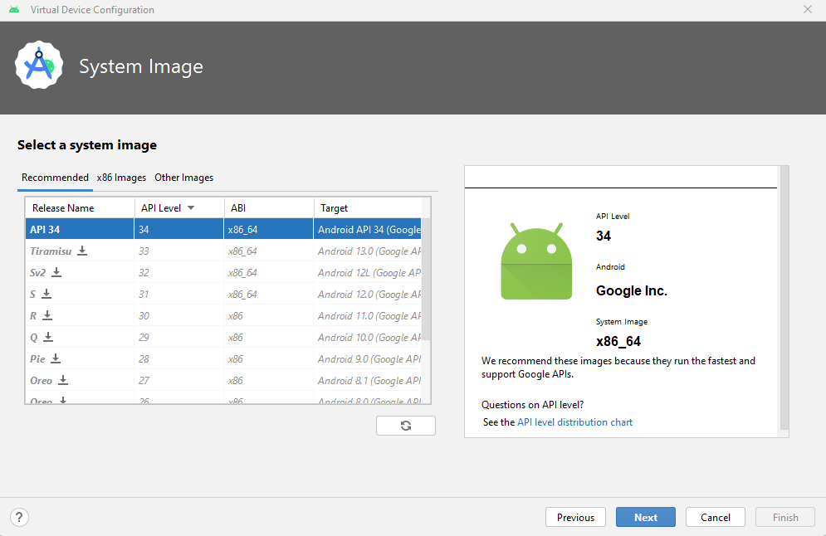
How to download emulator
Select System image.

Slide 15
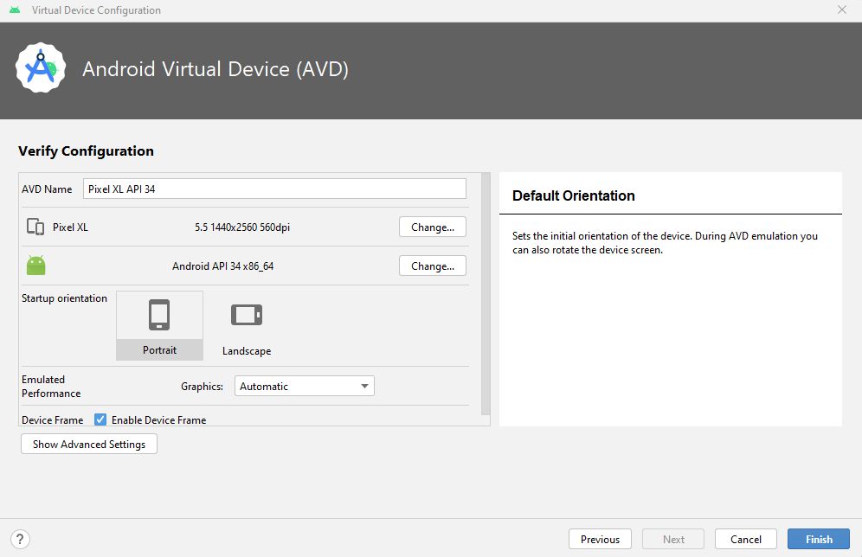
How to download emulator
Android virtual device, please note that orientation should be in Portrait mode.

Slide 16
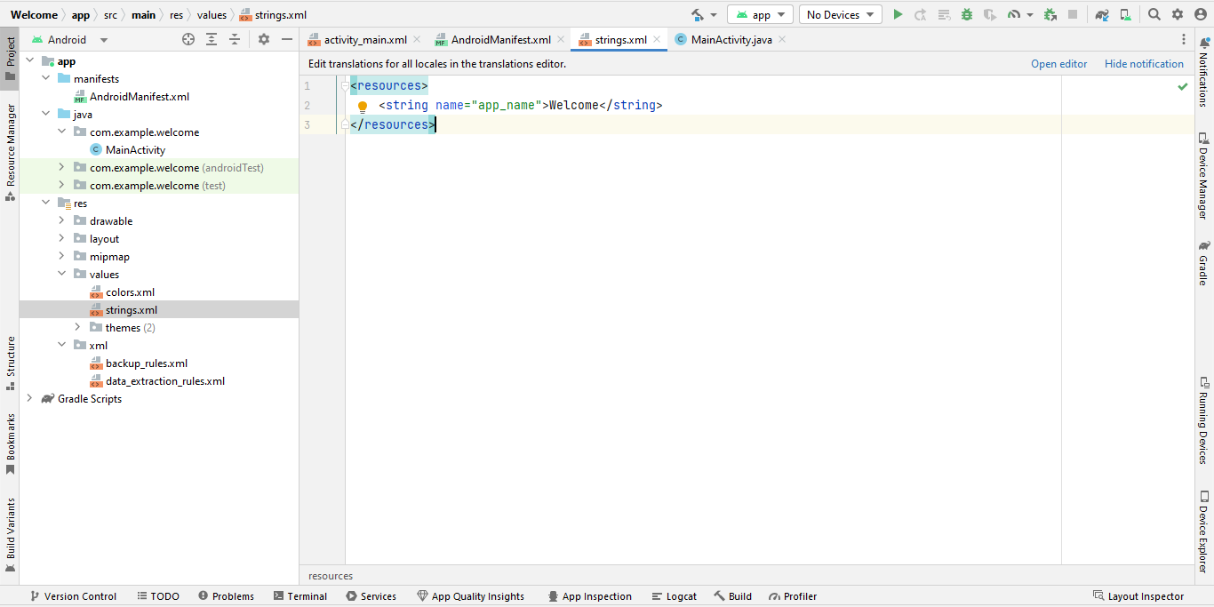
Changing app name
We can also change the app name in strings.xml file to the app name you wish to give as shown below.

Slide 17
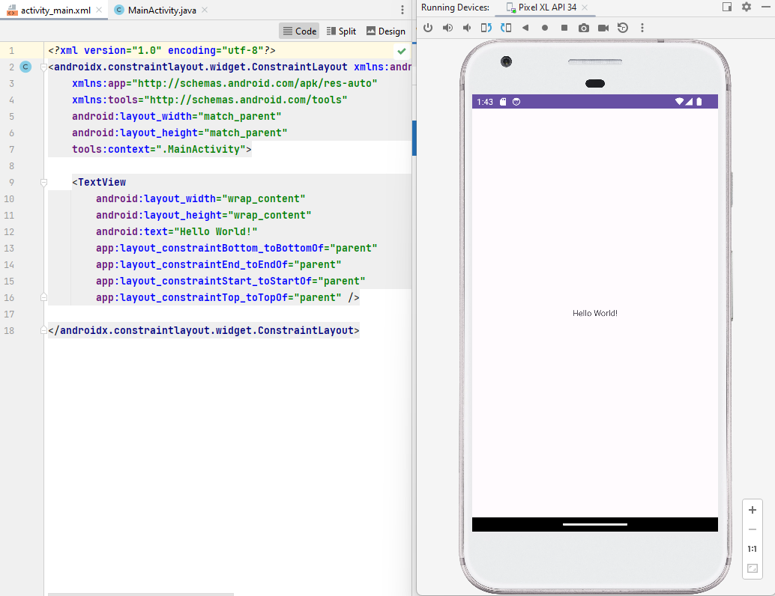
Running the project in emulator
Welcome text would be Hello World! by default.

Slide 18
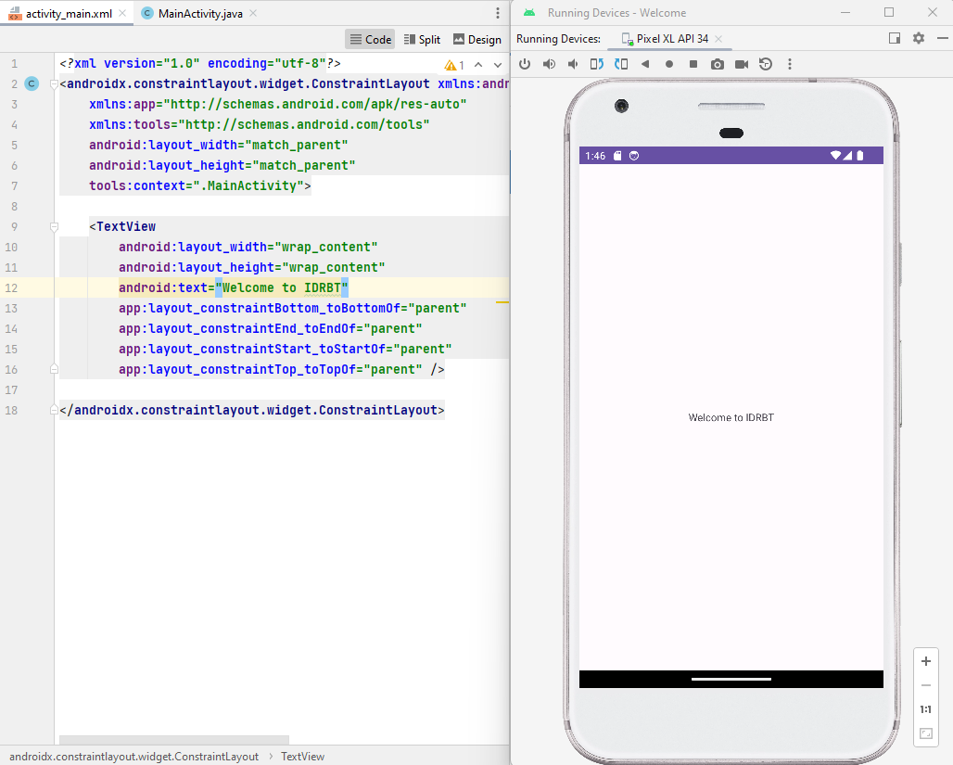
Running the project in emulator
We can change the welcome text to the text we wish to see in the TextView. For example here we have changed the text from Hello World! to Welcome to IDRBT.

Slide 19
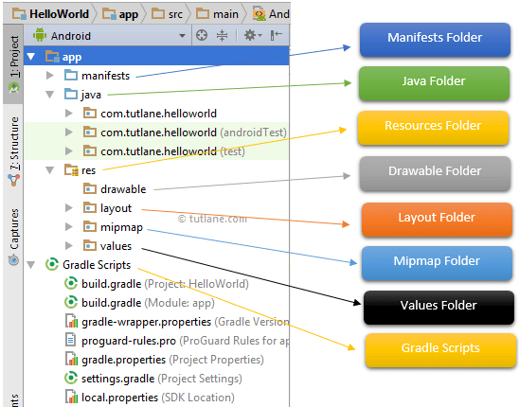
Android Project folder Structure
The android app project will contain different types of app modules, source code files, and resource files.

Slide 20
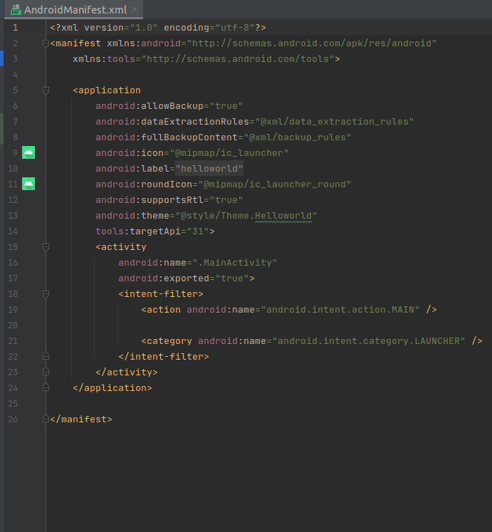
AndroidManifest.xml
AndroidManifest.xml stored in the root directory of its project hierarchy.
This file includes nodes for each of the Activities, Services, Content Providers and Broadcast Receiver.
That make the application and using Intent Filters and Permissions, determines how they co-ordinate with each other and other applications.

Slide 21
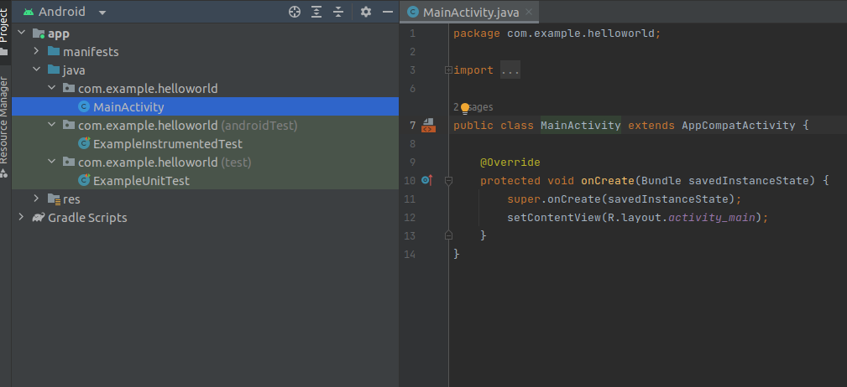
Java Folder
This folder will contain all the java source code (.java) files which we’ll create during the application development, including JUnit test code.
we create any new project/application, by default the class file MainActivity.java will create automatically under the package name “com.example.helloworld”

Slide 22
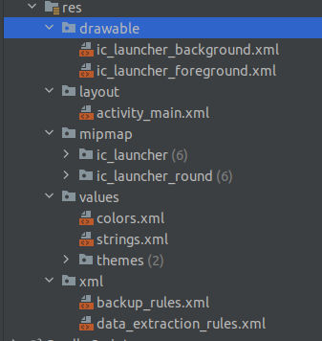
res (Resources) Folder
It’s an important folder that will contain all non-code resources, such as bitmap images, UI strings, XML layouts.

Slide 23
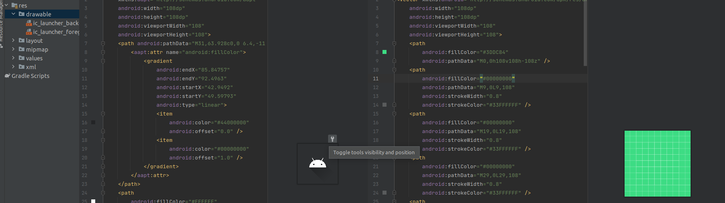
Drawable Folder (res/drawable)
It will contain the different types of images as per the requirement of application. It’s a best practice to add all the images in a drawable folder other than app/launcher icons for the application development.

Slide 24
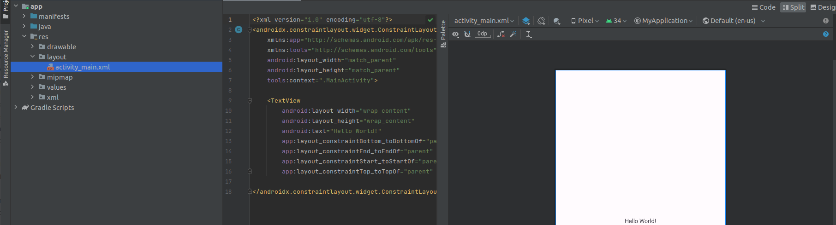
Layout Folder (res/layout)
This folder will contain all XML layout files which we used to define the user interface of our application. Following is the structure of the layout folder in the android application.

Slide 25
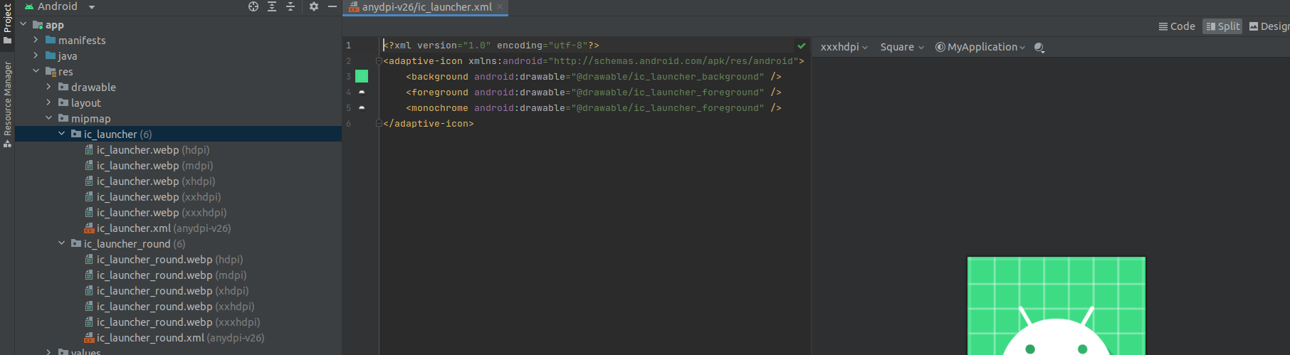
Mipmap Folder (res/mipmap)
This folder will contain app / launcher icons that are used to show on the home screen.
It will contain different density type of icons such as hdpi, mdpi, xhdpi, xxhdpi, xxxhdpi,to use different icons based on the size of the device.

Slide 26
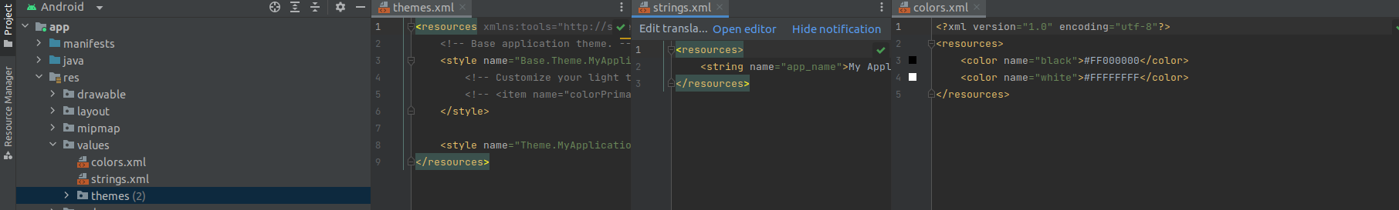
Values Folder (res/values)
This folder will contain various XML files, such as strings, colors, style definitions and a static array of strings or integers. Following is the structure of the values folder in android application.

Slide 27
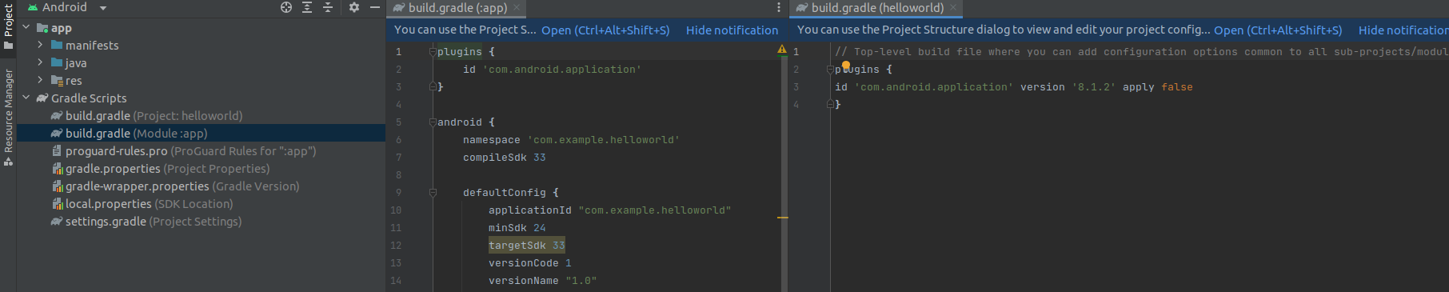
Gradle Scripts
In android, Gradle means automated build system and by using this we can define a build configuration that applies to all modules in our application.
In Gradle build.gradle (Project), and build.gradle (Module) files are useful to build configurations that apply to all our app modules or specific to one app module.

Slide 28
THANK YOU

